Slide 1
Software Engineering
Homework Alarm System
10조

Slide 2

Contents
제안 배경 및 필요성
관련 연구 및 현황
프로젝트 개요(아이디어)
목표 고객 및 기대 효과
Suggestion and needs
Related experiments and commercialized system example
Instruction to project(Idea)
Target and expected effect

Slide 3


Check
Usability
Comfort
Notification

Slide 4
System objective
Easy Check : Students can easily know there is any notice or assignment by just getting message.
Usability : Students don’t have to check i-campus. We can check only when message arrives.
Comfort : Students don’t have to worry about notice which they didn’t recognized.

Slide 5
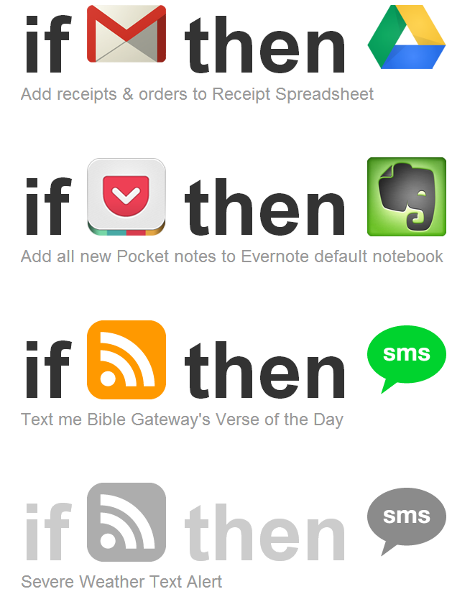

Notes:
There exists a decent application named “IFTTT”. It helps people to link different services and make easy automation process. And such a set of process is called recipe. There’s some interesting recipes exist. For example, you can get an email when the USA president signs a bill to law. You can get an email or notification on your phone when your favorite sports team wins or loses. If it’s going to rain, then send me an email. You can turn on your lights and devices and have them ready for you when you reached home without doing anything. Or the opposite, turn off the lights and devices without moving your hands.

Slide 6
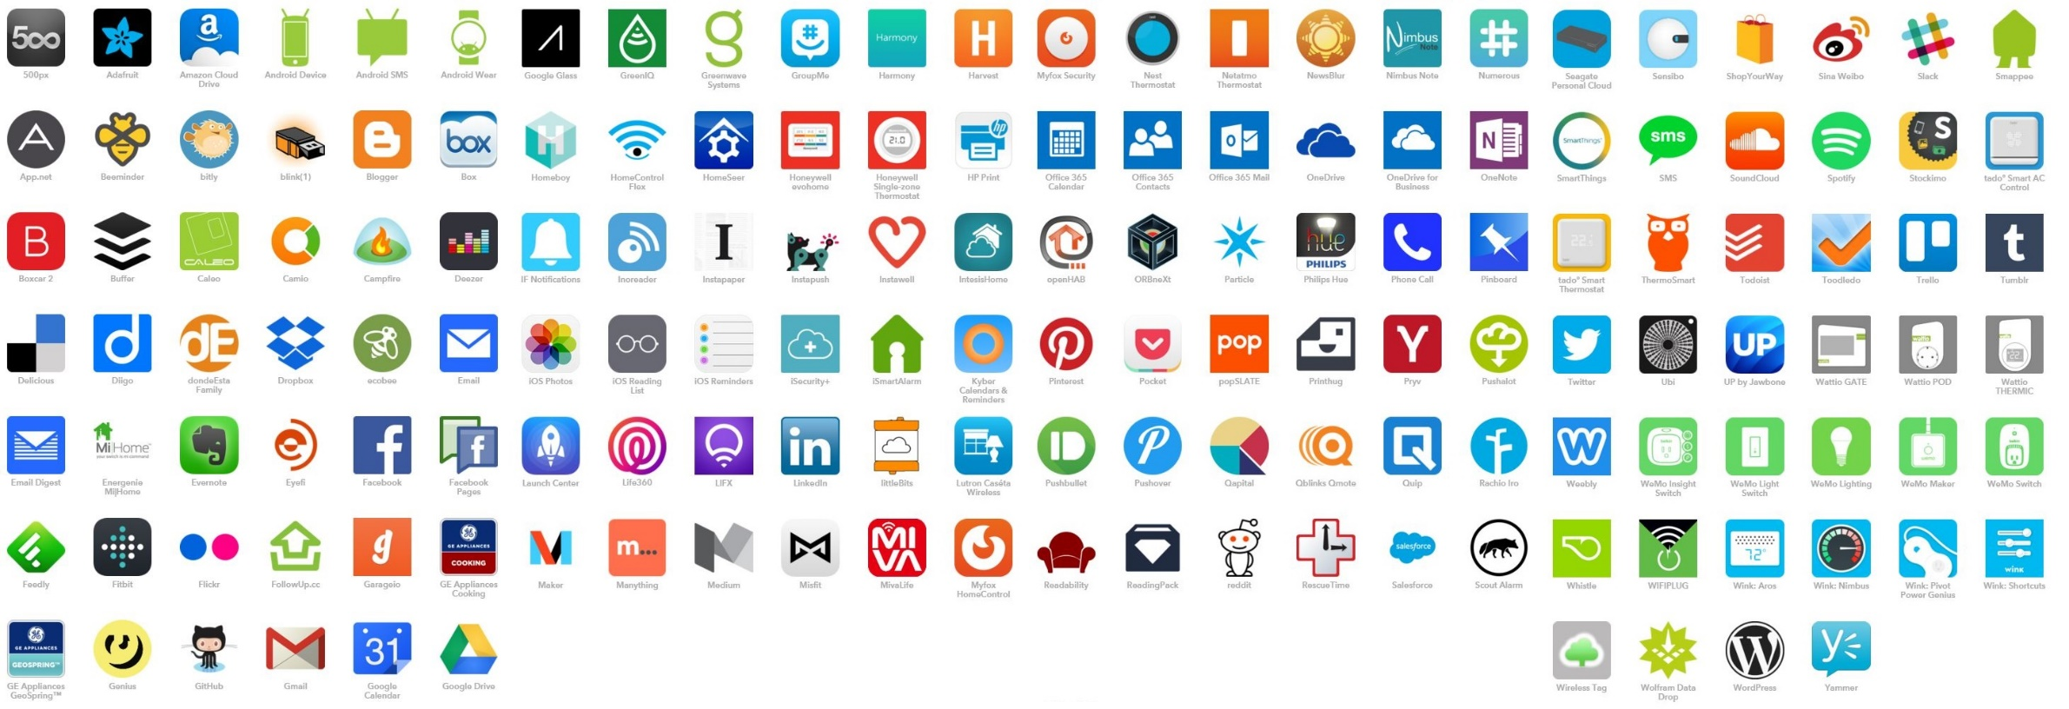
Notes:
These are the services that IFTTT supports. However, there’s one huge problem. It seems very promising and useful, though it only supports major services. In other words, you cannot directly apply this to the I-campus.

Slide 7
Existing program and difference
Google IFTTT : IF something arise THEN we can do or get something
example) IF “Whether text alarm” comes THEN give me “Message”.
Difference : Google IFTTT does not have any connections between i-campus.

Slide 8



Introduction of project
Professor
Professor
I-Campus
I-Campus
ALARM SERVICE
Students
Students

Slide 9

System architecture
I-Campus
If Professor post the notice, Alarm service will get a signal
ALARM SERVICE
We can see notice by conventional method
By using data in DB, Alarm Service will let the students get messages by SMS, E-Mail, KAKAO Talk
Students

Slide 10
Target customer & Expectancy effects
Target customer: All of I-campus user
Existing problem:
Expectancy effects
Smartphones are common and there are lots of app for e-mail reception
User: Time will be hugely reduced from notices to check
Unnecessary visit to I-campus will decrease
Publisher: They can easily notice important information to user

Slide 11
Reference
오래되고 답답한 아이캠퍼스 - http://www.campuslife.co.kr/news/articleView.html?idxno=20742에서 검색
“성균관대학교 모바일 아이캠퍼스 icon” - 성균관대학교 모바일 아이캠퍼스 3.0 1.0.18 Apk 에서 검색
Xiulin Sui, Yand Teng, Yong Qiu Chen, XueHui Wang. (2014). Design of Tool Automatic Identification and Database Management System Based on RFID. “4. Design of Database” (page: 136-138)
XueLian Feng, HaiYan Liu. (2013). Design of the Database of Library Information. “4. Design of Database” (page: 34-36)

Slide 12
Thank You !

Slide 13
Q and A !

